Slide 1

Introduction to Prompt Engineering
Master the art of communicating with AI models to unlock their full potential and transform your career in artificial intelligence.

Slide 2
FOUNDATION
What is Prompt Engineering?
Prompt Engineering is the process of designing clear, structured instructions that help AI models produce accurate, reliable, and high-quality outputs.
Bad vs. Good Prompts
❌ Bad: "Write something about AI."
LLMs don't think like humans—they generate text based on patterns and probabilities. Your prompts act like programming commands for the model.
✔️ Good: "Act as an AI professor. Explain Artificial Intelligence in 5 bullet points with simple language."
Result: Cleaner, more accurate output that meets your specific needs.

Slide 3

Why This Is a High-Income Skill
Market Demand
Business Impact
AI is everywhere—businesses desperately need people who can control and optimize AI outputs effectively.
Companies lose money due to bad prompts, hallucinations, and poor automation. You solve this problem.
Career Opportunities
AI automation & agents
Product development
Data analysis & code generation
SEO, marketing, customer support
$140K
₹12L
$150
US Salary Range
India Salary Range
Freelance Rate
Average starting salary up to $240K for experienced engineers
Entry-level positions up to ₹45 LPA for senior roles
Hourly rates from $50 to $150+ per hour

Slide 4

AI MODELS
Types of AI Models You'll Work With
Large Language Models (LLMs)
Vision Models
Multi-Modal Models
Models that understand images combined with text.
Models supporting text, image, audio, and video inputs.
Models that understand and generate text-based content.
Examples: GPT-4V, Gemini Vision, Claude Vision
Examples: GPT-5 Omni, Gemini Ultra, Claude Opus Vision
Examples: GPT-4, GPT-5, Claude 3, Gemini, Llama 3
Use cases: Image explanation, diagram understanding, code screenshot recreation
Use cases: Video analysis, audio transcription, image-to-code, multi-modal agents
Primary use for text generation, analysis, and conversation.

Slide 5

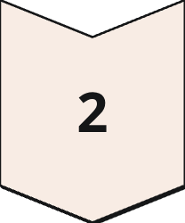
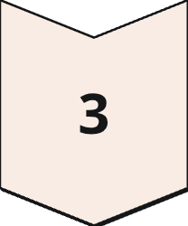
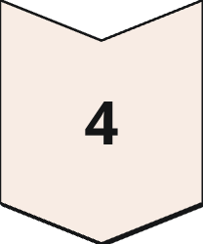
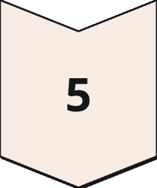

How LLMs Think: Basic Architecture
You don't need deep machine learning knowledge, but understanding how LLMs process information is essential for writing effective prompts.
User Prompt
Your instruction to the AI
Tokenization
Breaking text into tokens
Embedding
Converting to numbers
Transformer Layers
Processing with attention
Response
Generated output
Attention Mechanism: This determines which words matter most in your prompt. For example, in "The cat sat on the mat because it was tired," attention helps the LLM understand that "it" refers to "cat," not "mat."

Slide 6
TECHNICAL CONCEPTS
Tokens, Prompts & Key Parameters
Understanding Tokens
Critical Parameters
LLMs don't read full words—they read tokens. For example, "ChatGPT is amazing" might become: Chat, G, PT, is, amaz, ing.
Temperature
Controls creativity level (0–0.3: logical, 0.5–0.7: balanced, 0.8+: creative)
Why it matters: More tokens = higher cost + more computation time.
What is a Prompt?
Top-P
Controls output randomness, similar to temperature
A prompt is any instruction you give to AI. It can be a question, instruction, task, context, or example-based prompt.
System Message
Defines AI's role, behavior, and boundaries
Max Tokens
Limits the length of generated output

Slide 7
Mastering Different Prompt Formats
Understanding various prompt styles is critical for getting optimal results from AI models in different scenarios.
Instruct Format
Chat Format
Story Format
Direct instructions: "Explain quantum computing in simple words."
Role + message: "System: You are a math tutor. User: Explain Pythagoras theorem."
Used for fiction and creative writing scenarios.
Code Format
Structured Format
Requesting programming output: "Write a Python script to extract emails from text."
JSON, tables, bullet lists for organized data output.

Slide 8
COMMON PITFALLS
Mistakes That Beginners Make
Vague Instructions
Missing Output Format
Multiple Tasks Combined
❌ Bad: "Write an email."
❌ Bad: "Explain DBMS."
✔️ Good: "Write a formal email to HR requesting leave for medical reasons."
✔️ Good: "Explain DBMS in 5 bullet points with examples."
❌ Bad: "Explain AI, write a report, also give examples."
✔️ Good: Break complex requests into separate, focused steps.
Lack of Context
No Constraints Applied
LLMs need context to avoid hallucination. Always provide relevant background information and constraints.
Without boundaries, LLMs can overshoot. Define length, tone, format, and scope clearly.

Slide 9
Your Learning Roadmap
01
02
Foundation Understanding
Model Knowledge
Grasp what prompt engineering is and why it's valuable in today's AI landscape
Identify and understand different types of AI models and their capabilities
03
04
Technical Mastery
Format Expertise
Learn LLM basics, system messages, and parameter controls
Master temperature, tokens, and various prompt formatting techniques
05
06
Error Prevention
Practical Application
Recognize and avoid common prompting mistakes
Choose the correct prompt format for different tasks and scenarios

Slide 10

Ready to Begin?
You now have the foundational knowledge to start your journey as a prompt engineer. Module 1 has equipped you with essential concepts, terminology, and best practices.
You Now Understand
You're Ready To
Next Steps
Core principles of prompt engineering
Write effective prompts
Practice with real examples
Control AI model outputs
Experiment with parameters
How LLMs process information
Avoid common pitfalls
Move to advanced techniques
Key parameters and their effects

